Slide 1
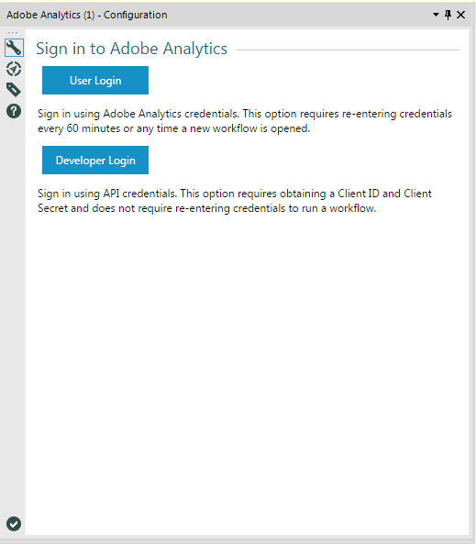
Add transparency for loading image
20% trans

Slide 2
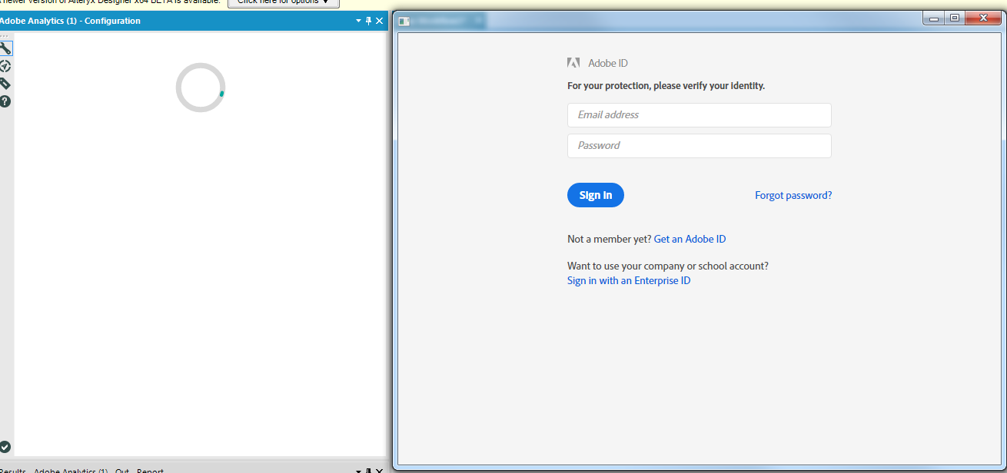
User Login
Add text to loading page to say to login to popup.
Sign in to Adobe within popup window

Slide 3
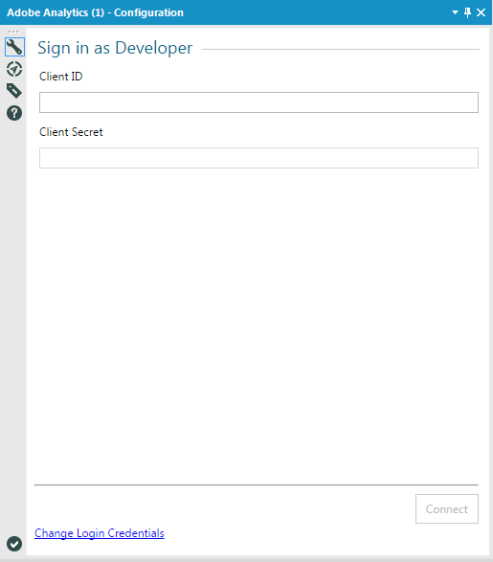
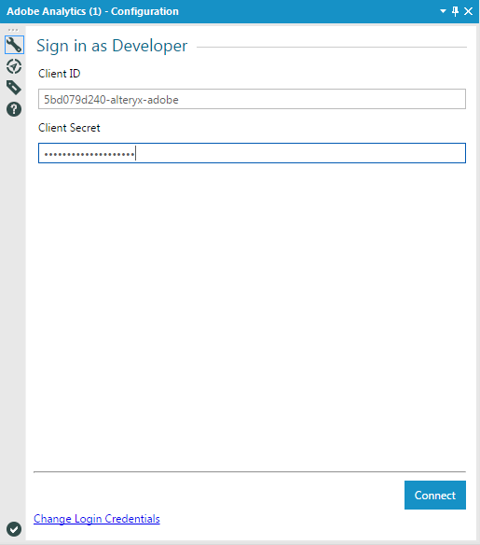
Developer Login

Slide 4
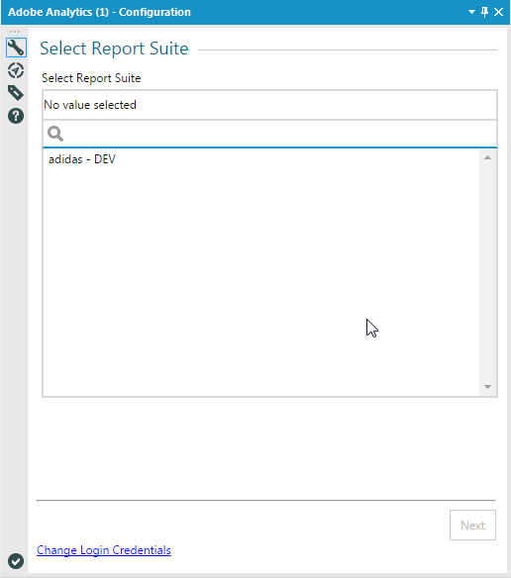
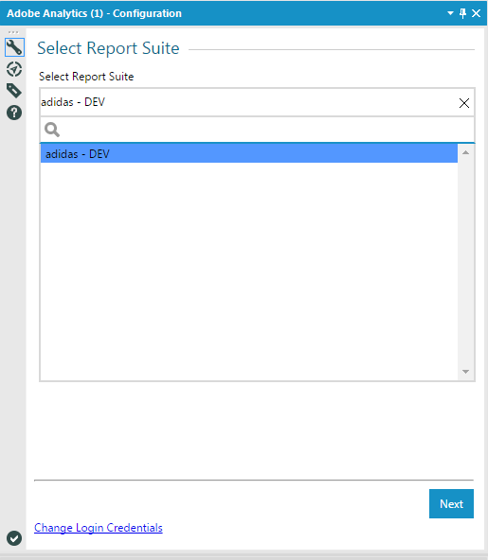
Remove widget title

Slide 5
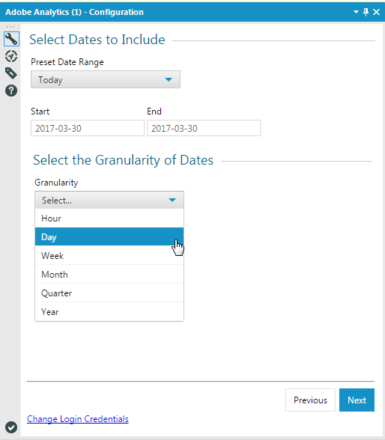
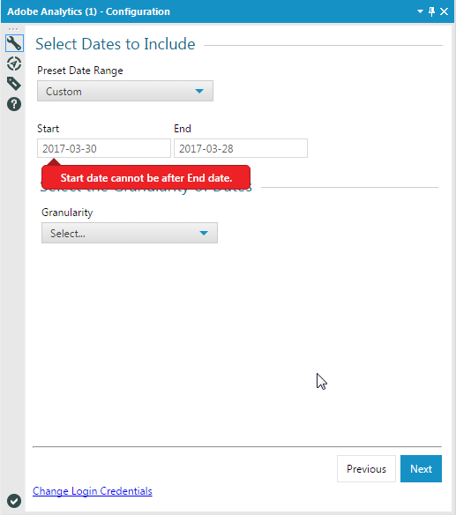
Select Dates and Granularity to Include
Granularity (Optional)

Slide 6
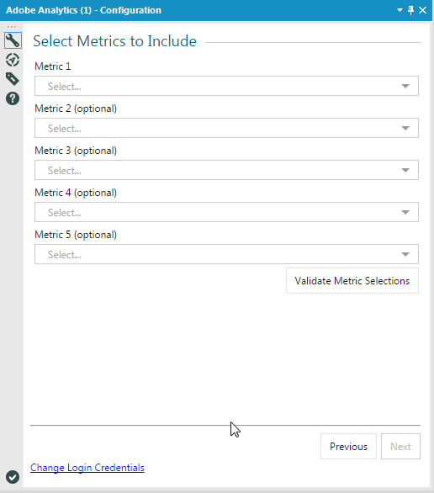
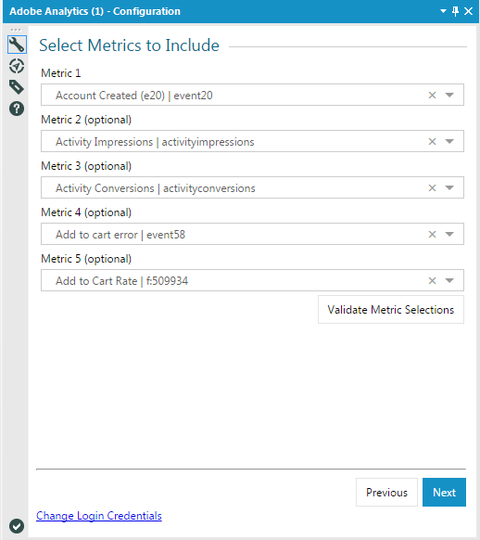
Have Validate Metric Selections button hidden if only 1 metric is selected

Slide 7
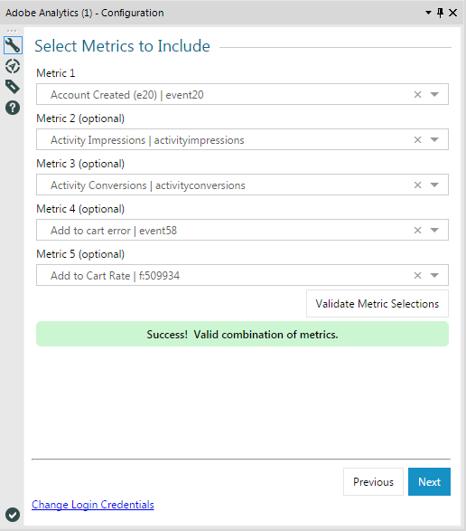
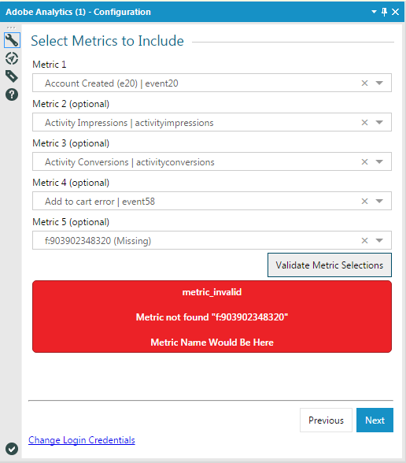
On click of Validate Metric Selections
Action Item for Kathy – re-work these error messages

Slide 8
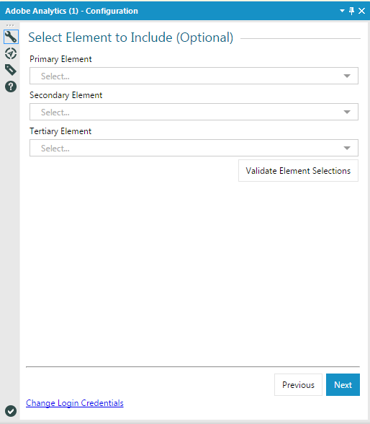
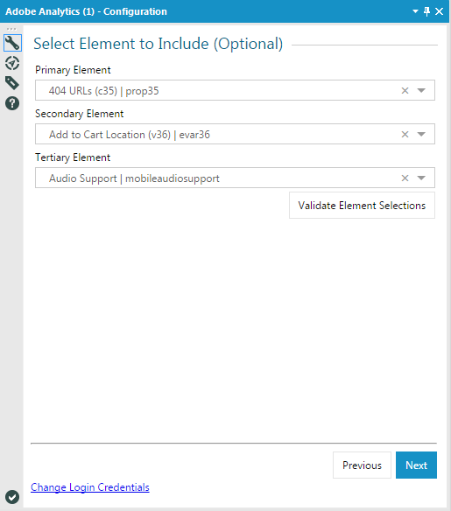

Slide 9
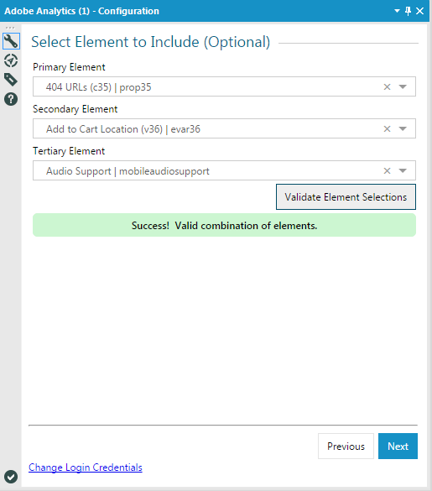
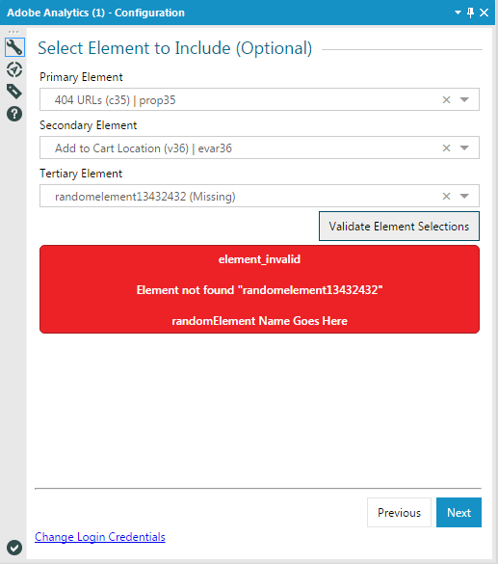
On click of Validate Element Selections

Slide 10
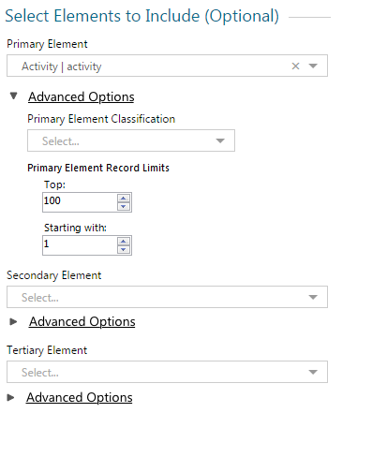
Same weight/size for all text
Keep underline for Advanced Options
Remove Primary and Element
Left align w/classification field
Top Record Limit:
Starting with Record:

Slide 11
Segments TBD

Slide 12
Summary TBD – But in same style as Google Analytics

